Slide 1
Name: Muhammad Sherjeel Ahktar
Section: BCS-2D

Slide 2


Slide 3
Topic:
Merits & demerits of online education"

Slide 4
Education
Two types of education.
1: Online Eductiaon
2: Physical Education

Slide 5
Merit of Online Education
1. Easily Accessible.
2. Wide variety of teachers.
3. Learning purpose.
4. Much more learning opportunities
5. Easy Way

Slide 6
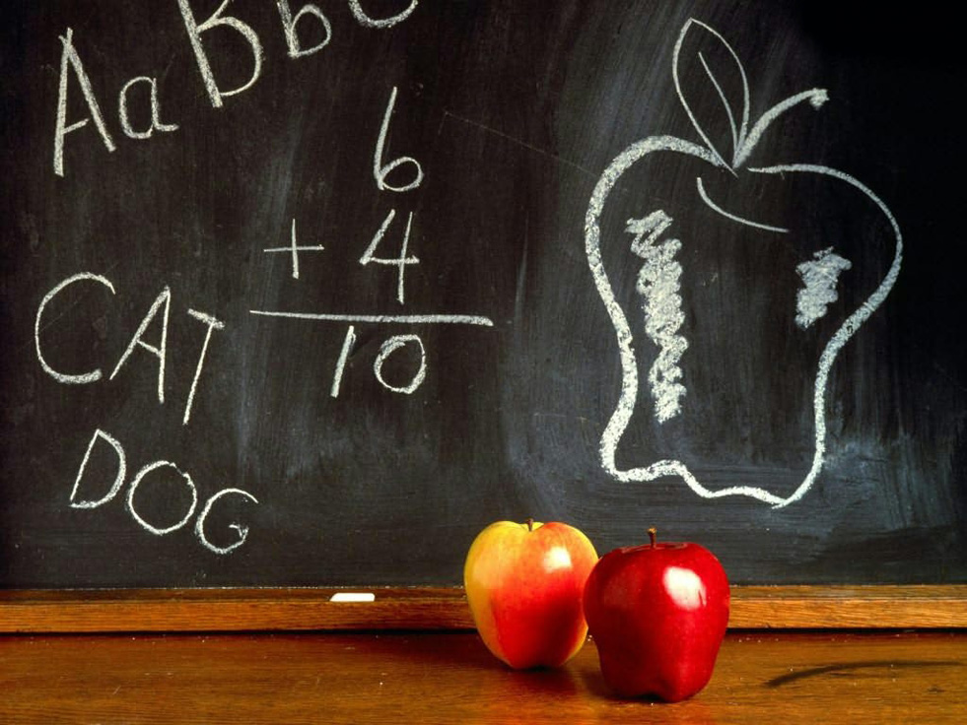

Slide 7
Merits of Physical Education
1. More Practical Work.
2. Live interaction with faculity.
3. Good enivronment
4. Lesser interuption.
5. Ask questions.

Slide 8
Conclusion
1: Both are source of education.
2: Both are way of getting education.

